Slide 1
Comparison slide
CoLaborers International
We are a diverse group of believers serving alongside our global brothers and sisters to help women and children in Zambia and India.
Started by Melissa Davis Stuebing in 2007.
We believe in connecting your field of study to the mission field and giving tangible ways to use what God has put inside of you to help other people.
Serve in your field of study abroad or via telecommuting
Professional Development Trainings
Missionary Service
Child Sponsorship

Slide 2
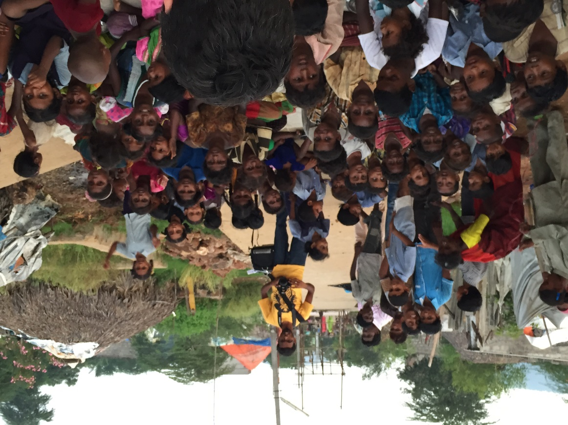
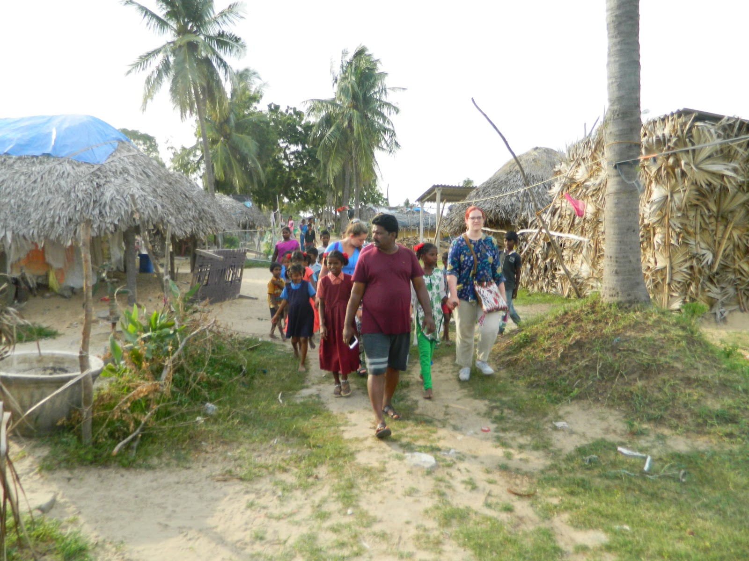
HOPE FOR INDIA
Child Sponsorship Program (2009-current) – all children sponsored.
HOW DO WE REACH MORE?
In 2015, while walking in the slums we had a vision to start a mobile outdoor school.
2018, started a mobile outdoor slum school to bring education into areas without any schools.
Curriculum jointly developed together by Sarah Pinard, special educator and curriculum author in state of PA and Karuna Annavarapu, elementary education teacher in India.
Teams have included Americans and Indians education volunteers and this year, also Zambians!

Slide 3
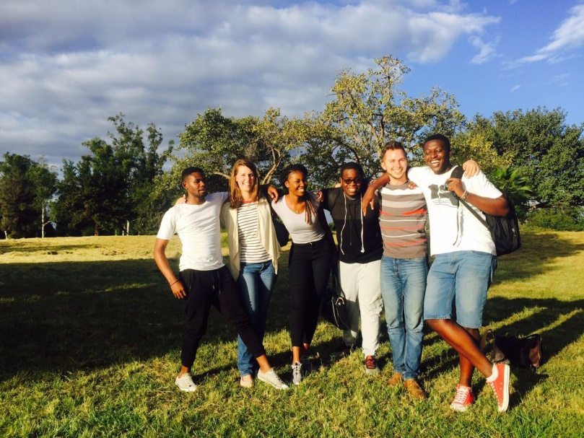
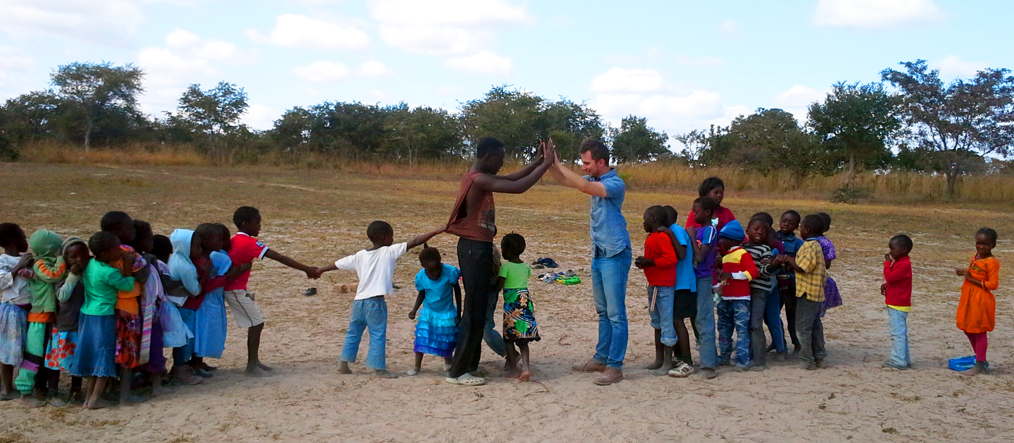
ZAMBIA, AFRICA
2012 - Started assisting Chisomo Centers in reaching street children & empowering women.
Interns, missionaries, trainings, scholarship programs for street kids to go to school, education programs for school readiness
2015 - current - women’s economic empowerment programs
2015 - Introduction of “Literacy-Free 12 Step Expressive Arts Therapy” curriculum for drug addicted youth
2018 - Country-wide training to 36 organizations.
2020 – Opening a field office. Are you called?

Slide 4
CoLaborers.com

